Slide 1
Graph Neural Network
Date: 25/03/2021
Venue: VinBigData
Reporter: Cuong Vo

Slide 2
Recap
Drug-Disease Association(DDA)
Drug-Drug interaction (DDI)
Protein-Protein interaction (PPI)
Goal: Utilizing Graph Embedding to learn low-dimensional node representations.
Biomedical link prediction
Tasks
Medical Term Semantic type Classification
Protein Function Prediction
Node classification tasks

Slide 3
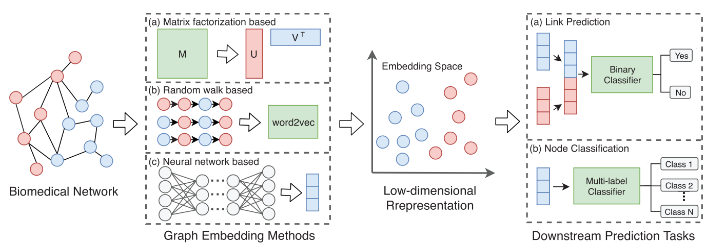
Recap

Slide 4
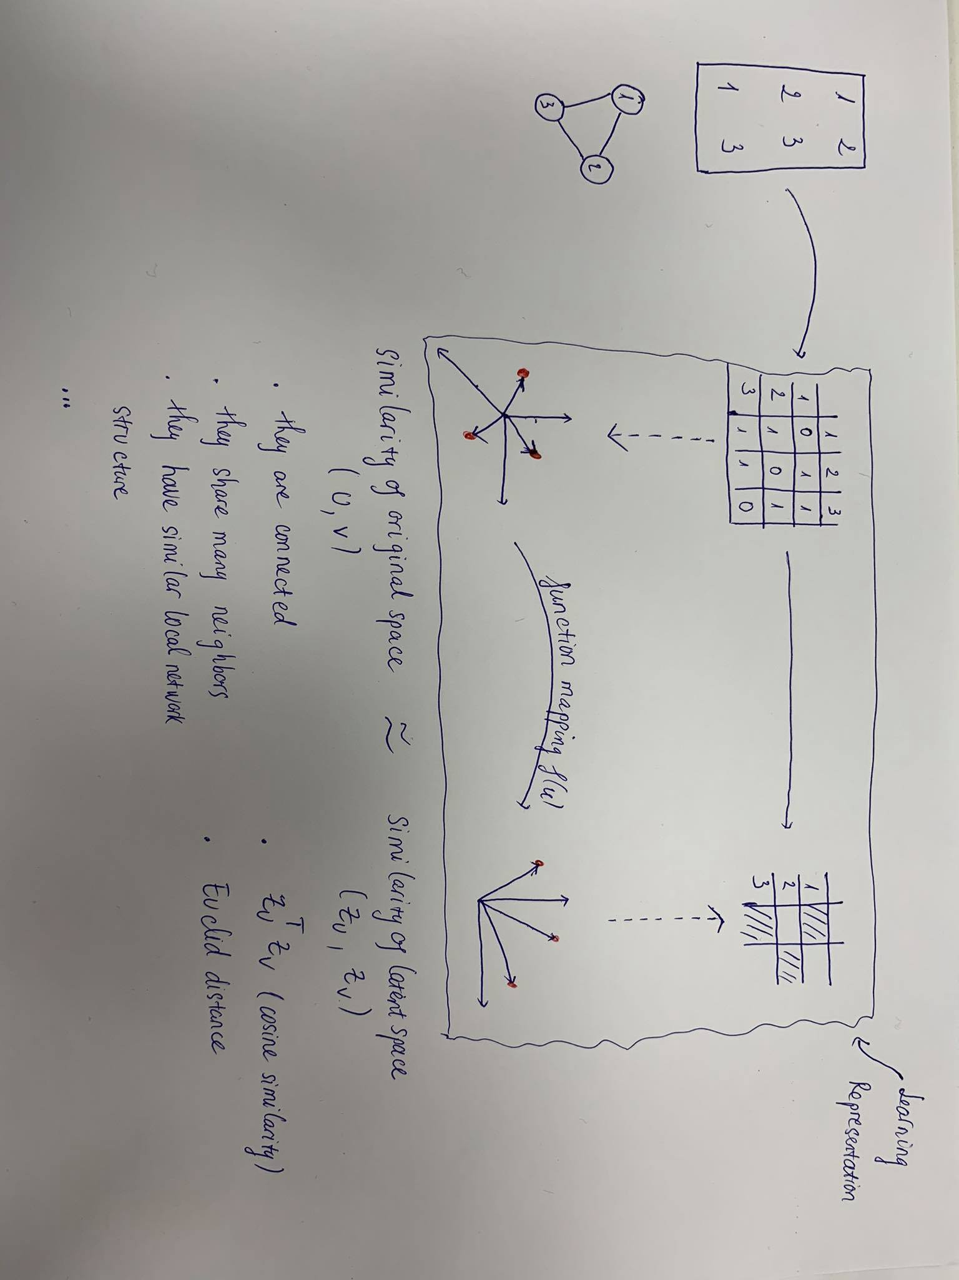
Recap

Slide 5
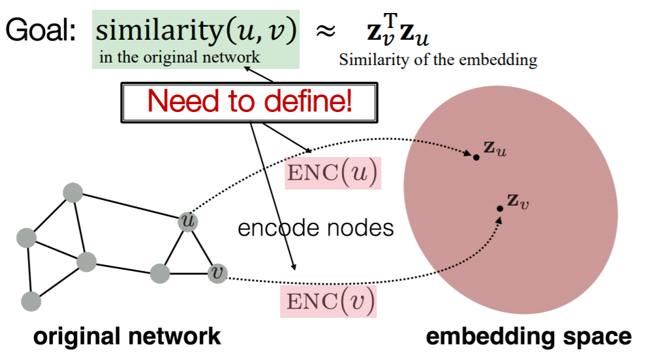
Recap

Slide 6
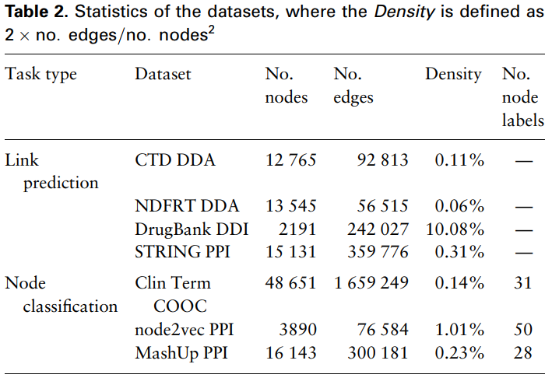
Recap
Notes:
- The link prediction task can be formulated as: given a set of biomedical entities and their known interactions, we aim to predict other potential interactions between entities (The assumption behind these methods is that entities sharing similar biological features or graph features could have similar connections) - Protein function prediction - Given a medical term co-occurrence graph where terms and co-occurrence statistics have been extracted from clinical texts, classify the semantic types of medical terms

Slide 7
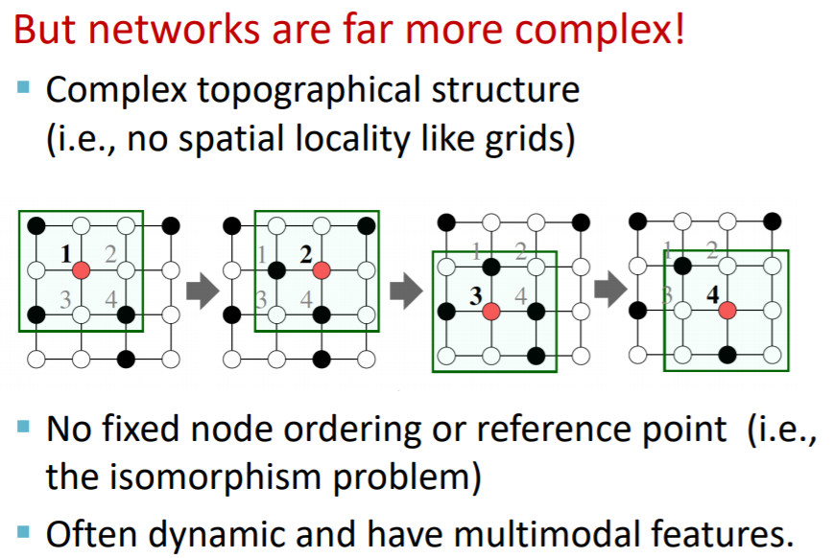
Recap

Slide 8
Recap Graph Embedding Methods
Laplacian
SVD
GF
HOPE
GraRep
First-order proximity
MF-based
High-order proximity
Graph Embedding Methods
DeepWalk
Node2vec
struc2vec
Random Walk-based
High order proximity
LINE
SDNE
GAE
First and Second order proximity
Neural Network-based
Notes:
MF based: it aims to factorize a data matrix into lower dimensional matrices and still keep the manifold structure and topological properties hidden in the original data matrix.
Random Walk based: tries to learn word representations from sentences, random walk-based methods are developed to learn node representations by generating ‘node sequences’ through random walks in graphs.
NN based: such as multilayer perceptron (MLP), autoencoder, generative adversarial network (GAN) and graph convolutional network (GCN).

Slide 9
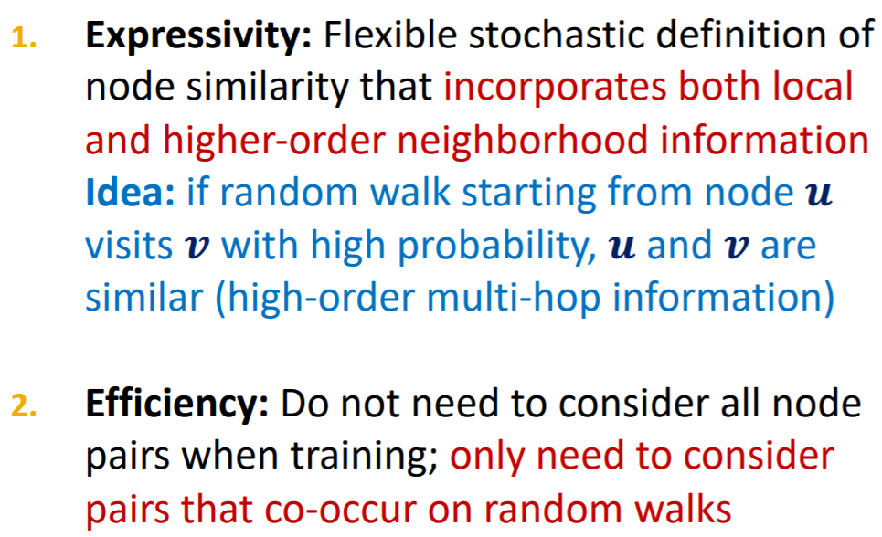
Recap Random Walk

Slide 10
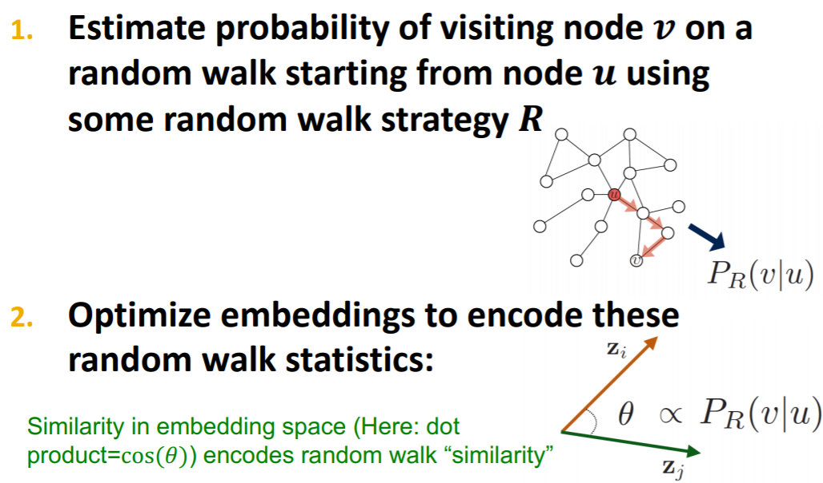
Recap Random Walk

Slide 11
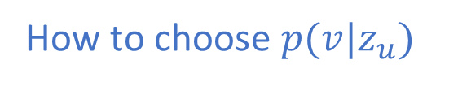
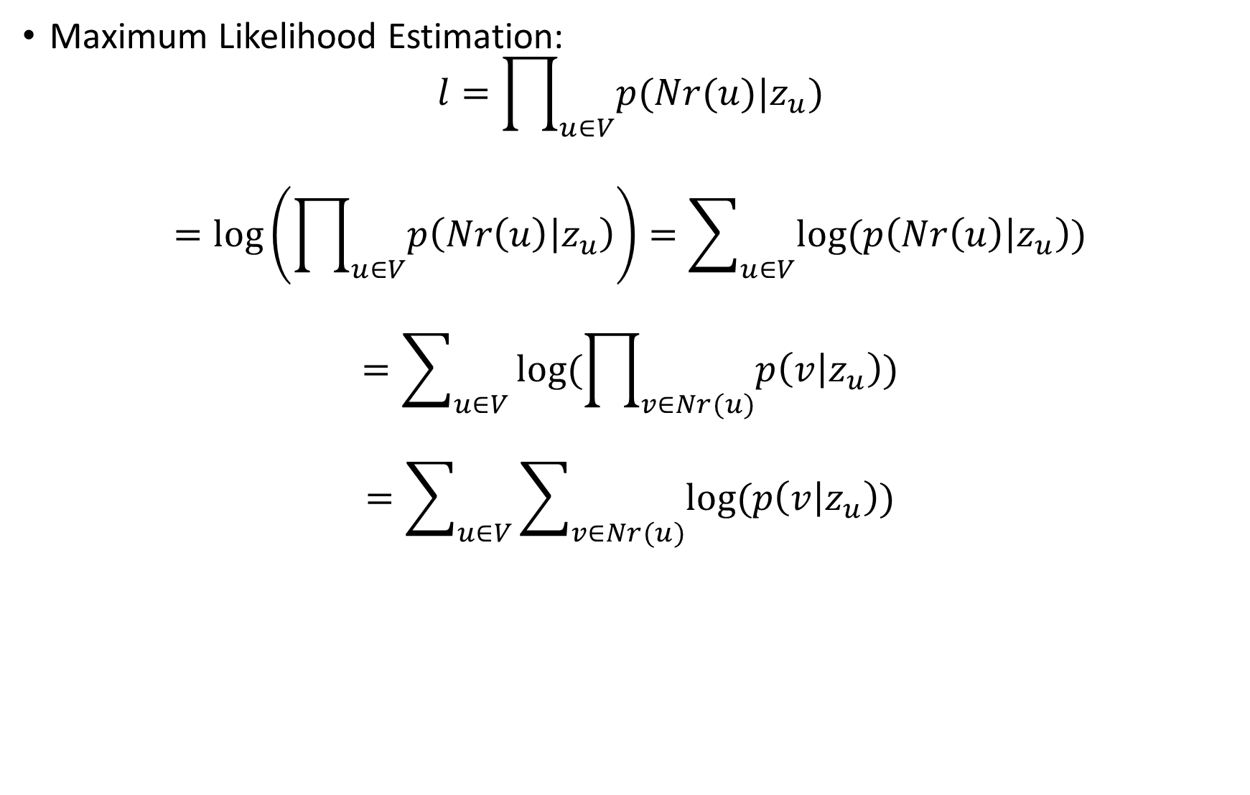
Recap Random Walk
Maximum Likelihood Estimation:
$$l=\prod_{u∈V}{p(Nr(u)|z_{u})}$$
$$=\log\left(\prod_{u∈V}{p\left(Nr\left(u\right) | z_{u}\right)}\right)=\sum_{u∈V}{log⁡(p\left(Nr\left(u\right) | z_{u}\right))}$$
$$=\sum_{u∈V}{log⁡(\prod_{v∈Nr(u)}{p\left(v | z_{u}\right)})}$$
$$=\sum_{u∈V}{\sum_{v∈Nr(u)}{log⁡(p\left(v | z_{u}\right))}}$$
How to choose $p(v|z_{u})$

Slide 12
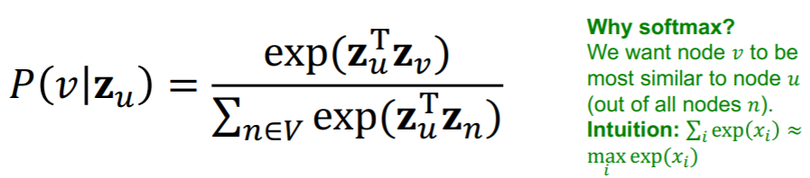
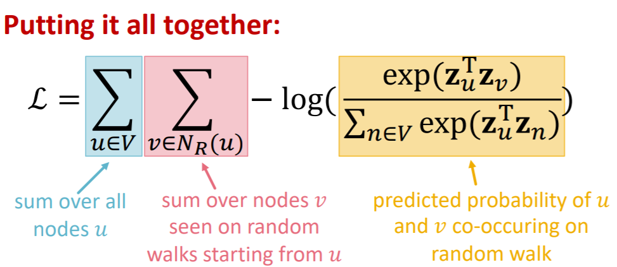
Recap Random Walk

Slide 13
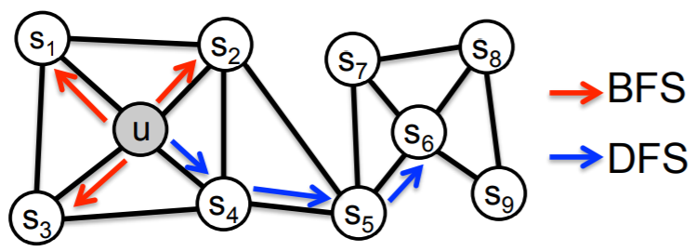
Recap Random Walk
DeepWalk: Walking randomly in Graph.
Node2Vec: Balance between exploitation and exploration.
Exploitation -> BFS -> Local microscopic view -> Topological Structure.
Exploration -> DFS -> Global microscopic view -> Structure Roles.
Deep Walk: Preprocessing data bases on structural similarity + Node2Vec.

Slide 14
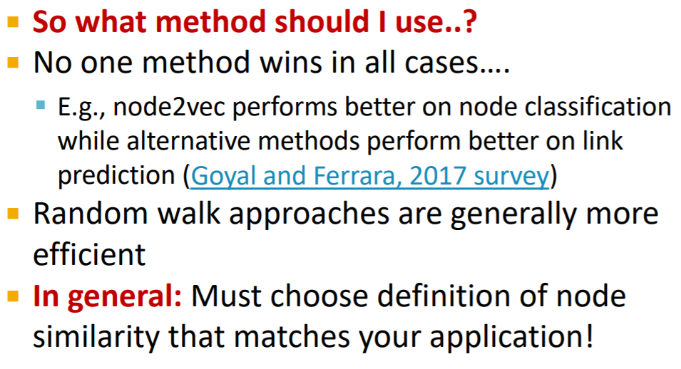
Recap Random Walk

Slide 15
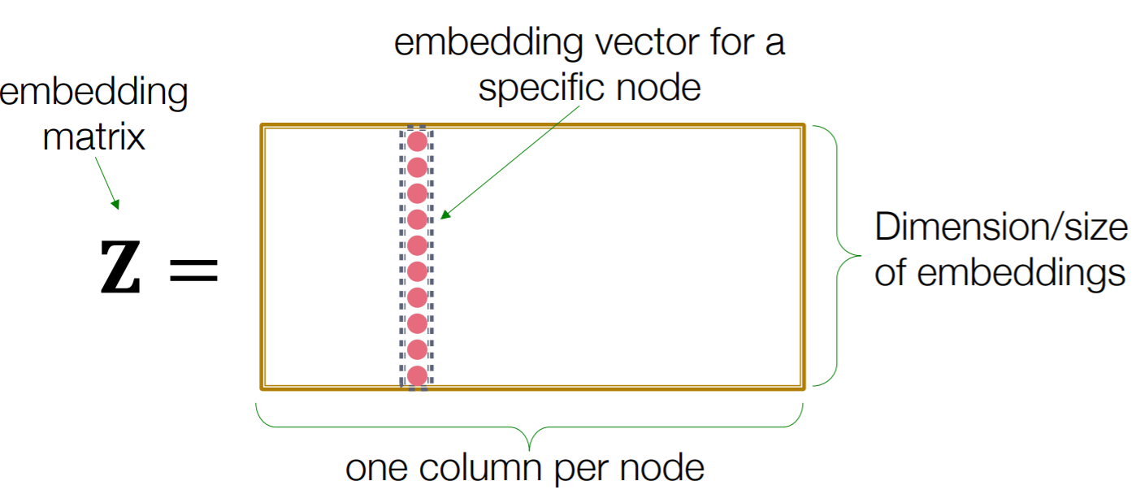
Graph Neural Network

Slide 16
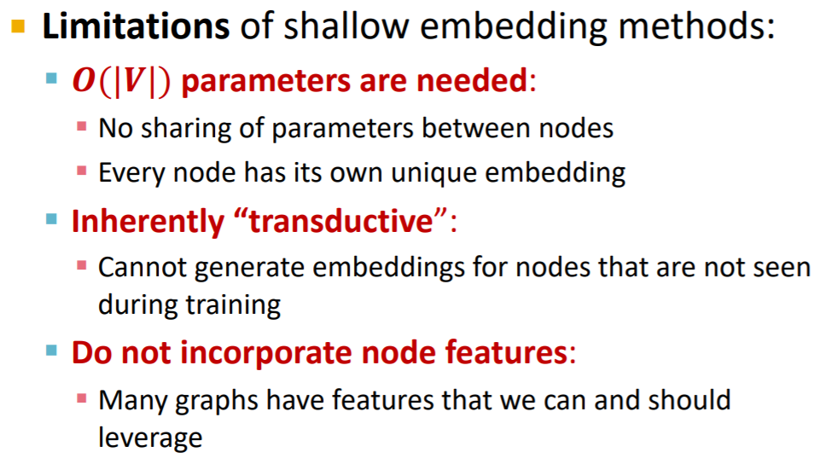
Graph Neural Network

Slide 17
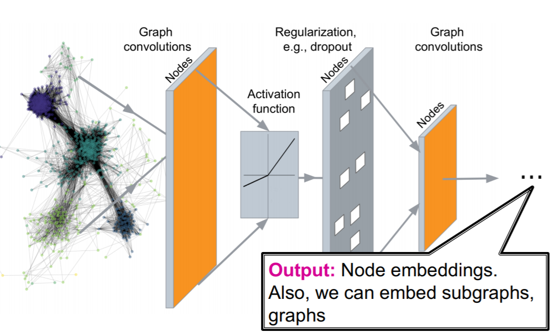
Graph Neural Network

Slide 18
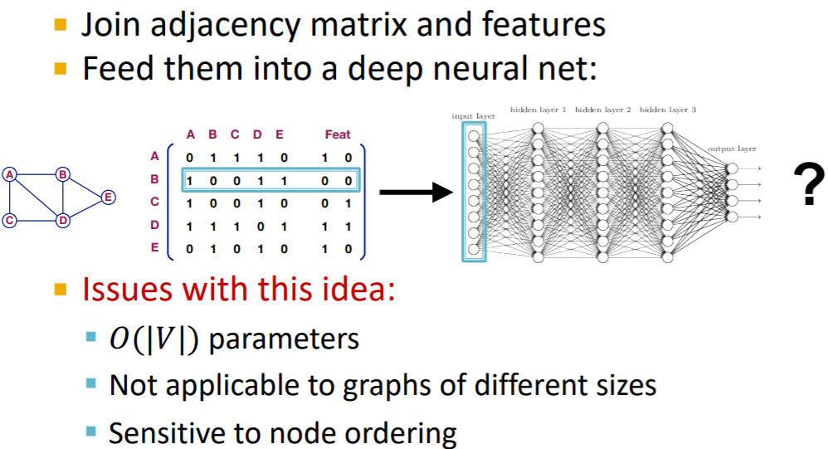
Naïve Approach Graph Neural Network

Slide 19
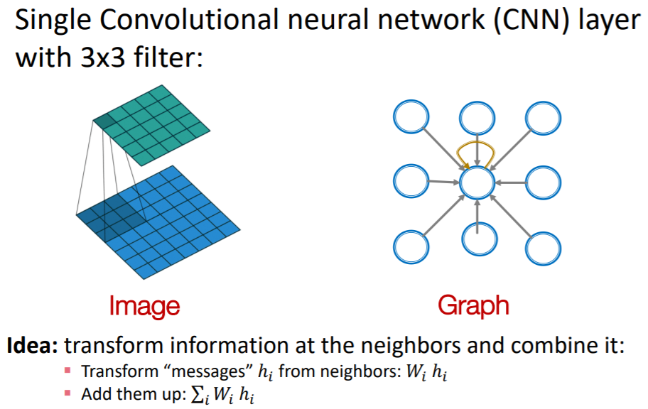
Idea Of Graph Neural Network

Slide 20
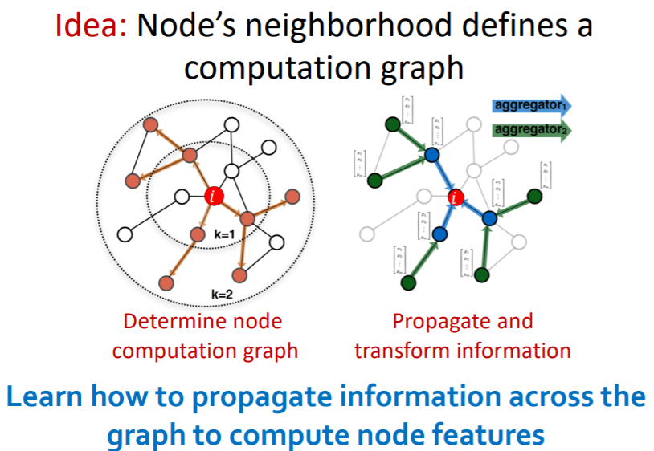
Graph Neural Network

Slide 21
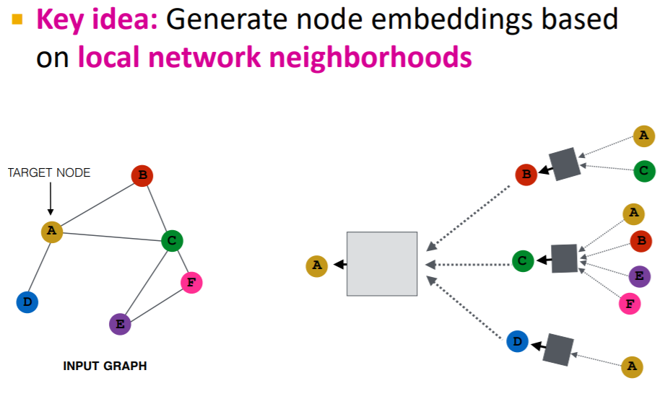
Graph Neural Network

Slide 22
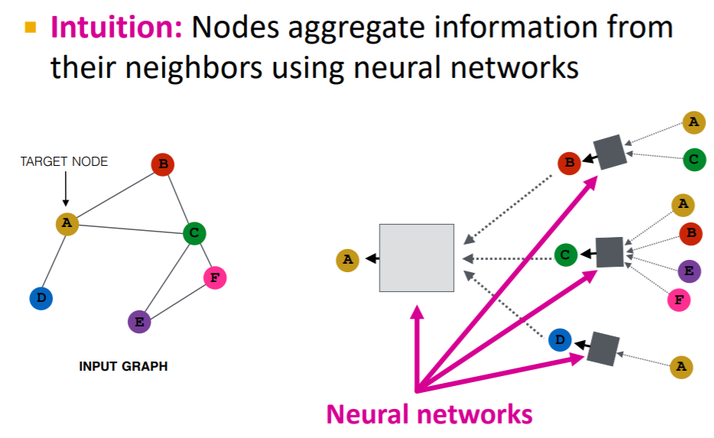
Graph Neural Network

Slide 23
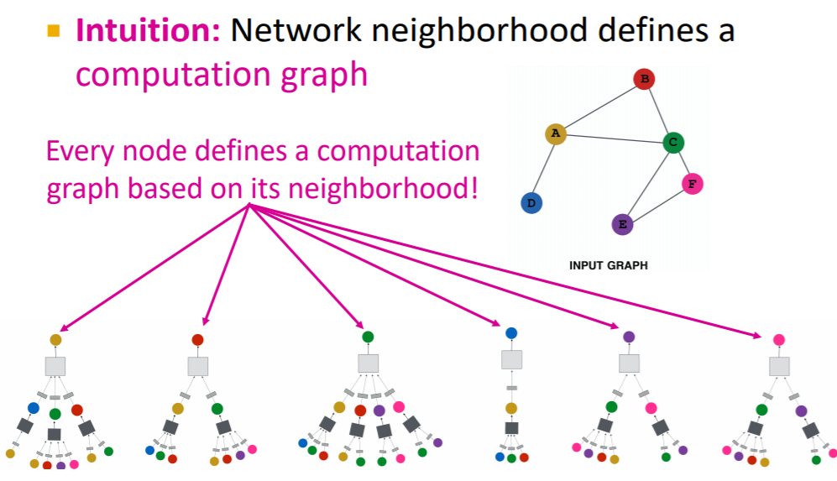
Graph Neural Network

Slide 24
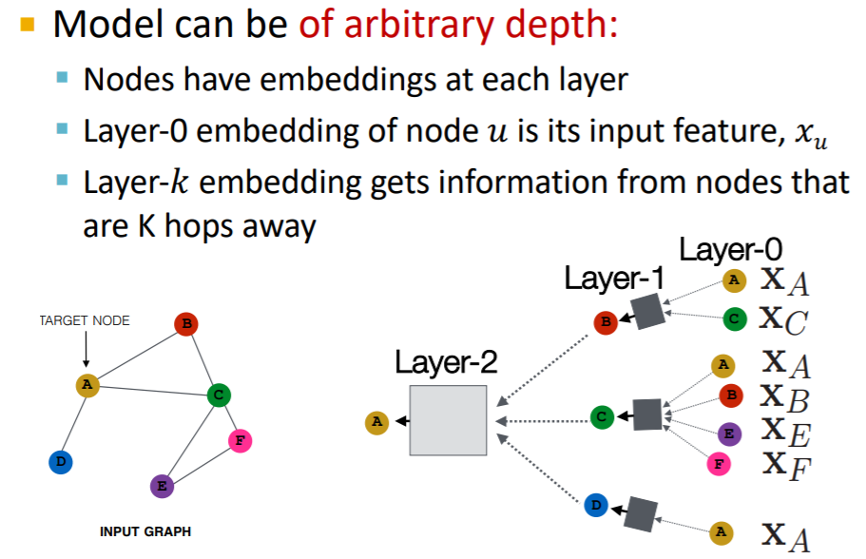
Graph Neural Network

Slide 25
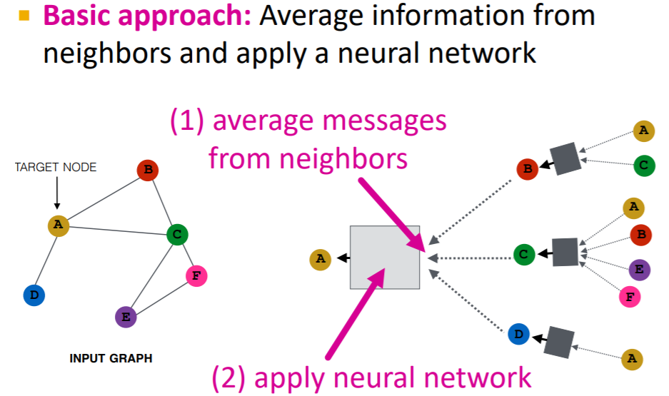
Graph Neural Network

Slide 26
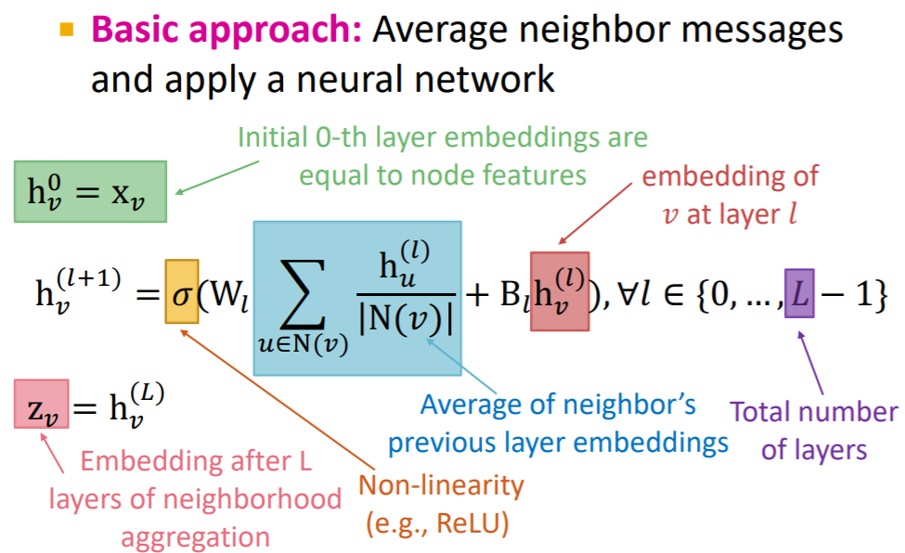
Graph Neural Network

Slide 27
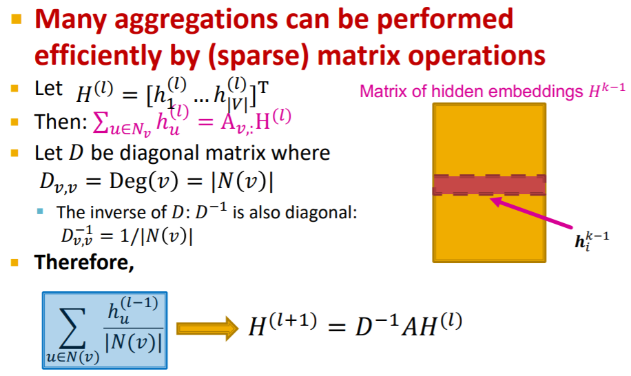
Graph Neural Network

Slide 28
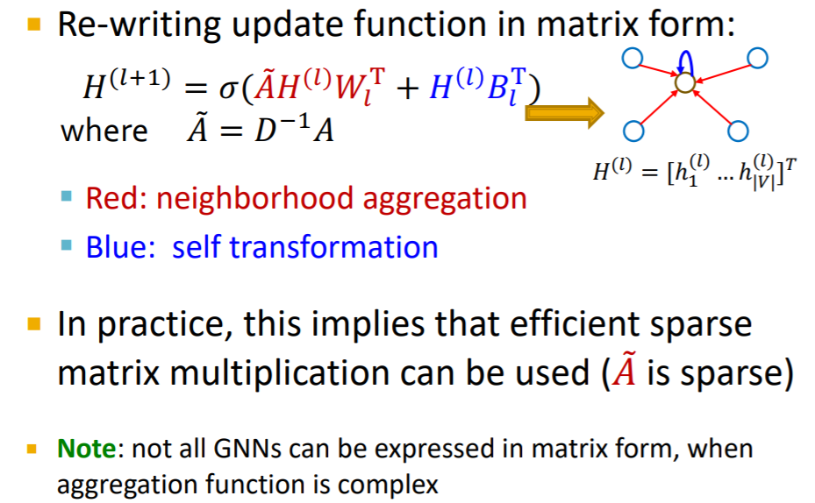
Graph Neural Network

Slide 29
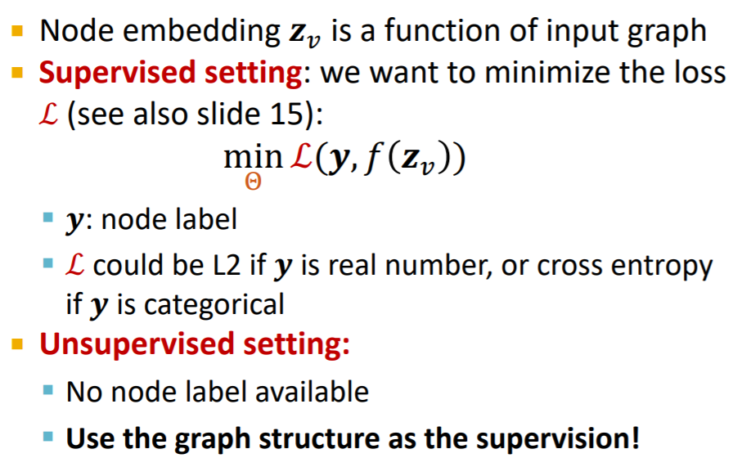
Graph Neural Network

Slide 30
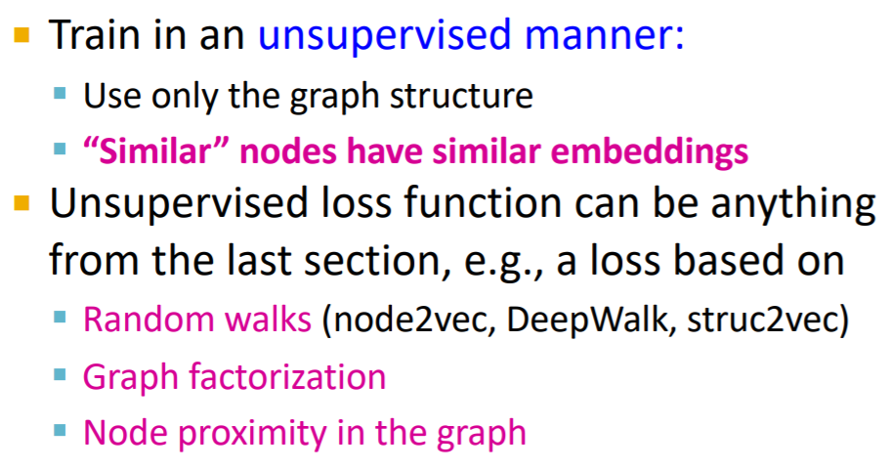
Graph Neural Network

Slide 31
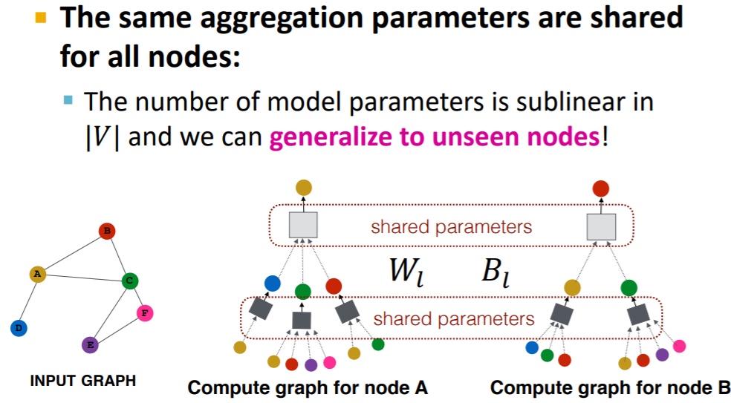
Graph Neural Network

Slide 32
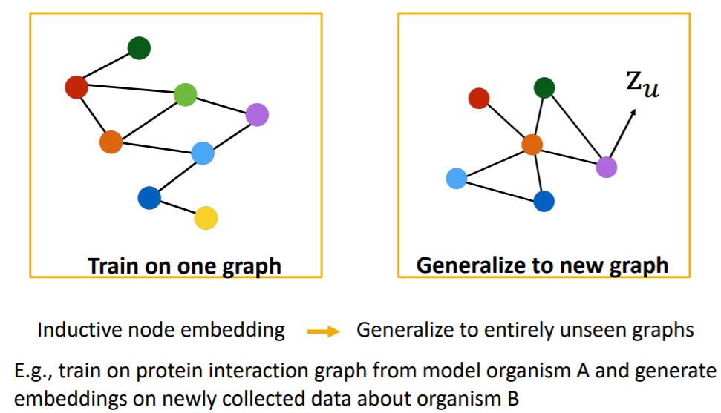
Graph Neural Network

Slide 33
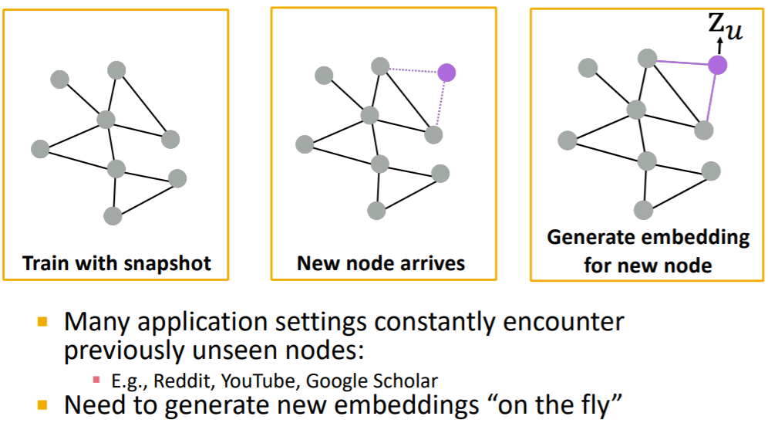
Graph Neural Network

Slide 34
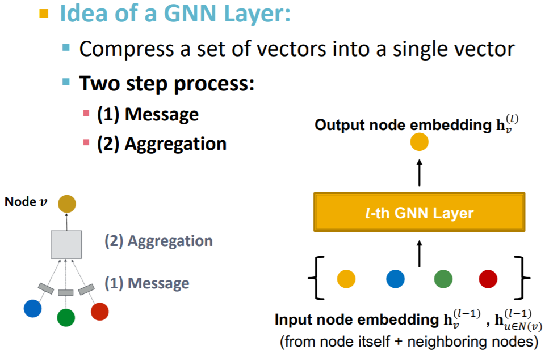
Graph Neural Network

Slide 35
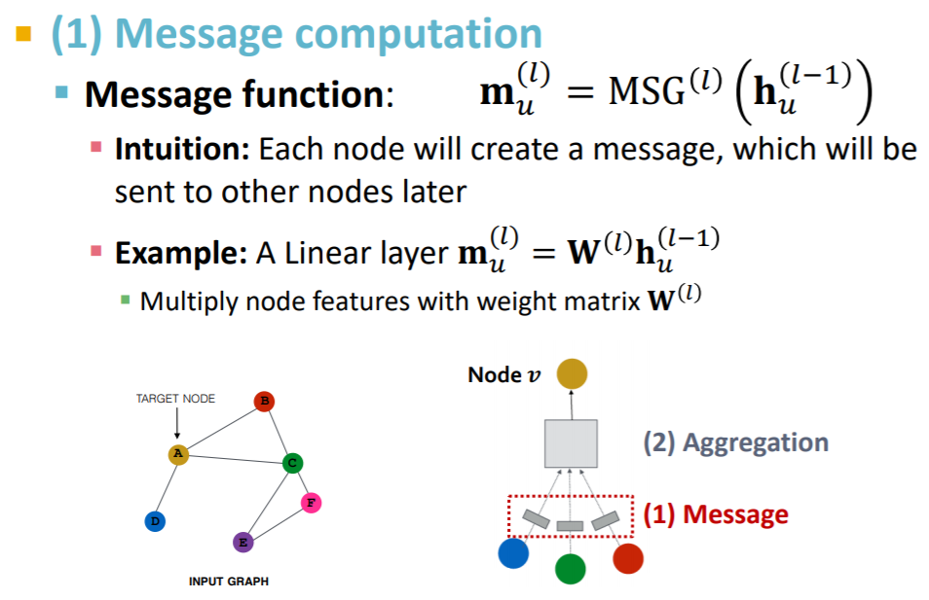
Graph Neural Network

Slide 36
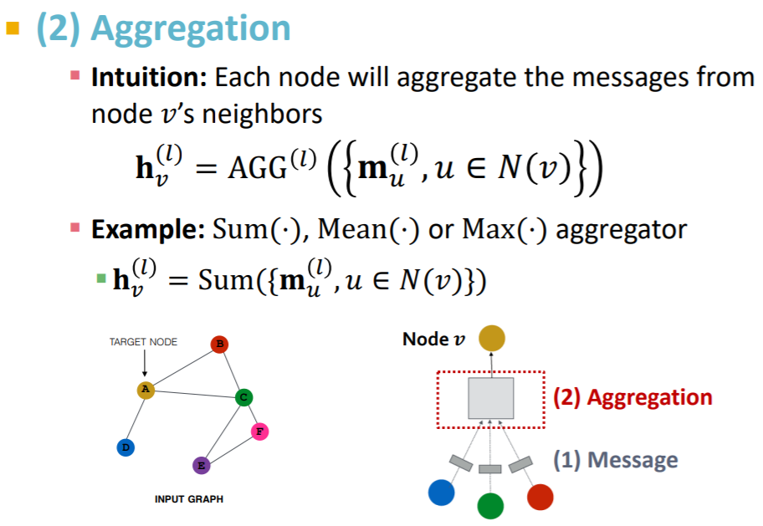
Graph Neural Network

Slide 37
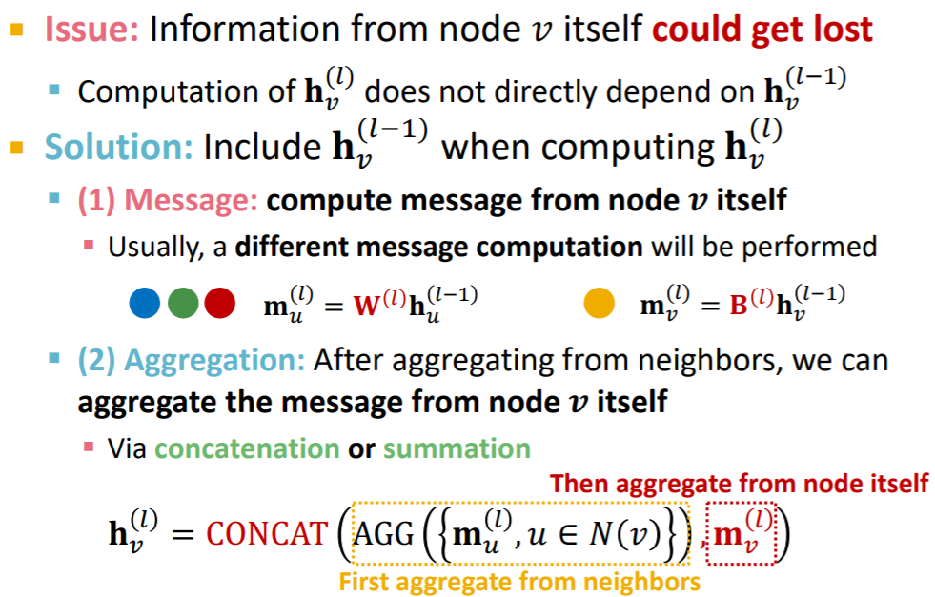
Graph Neural Network

Slide 38
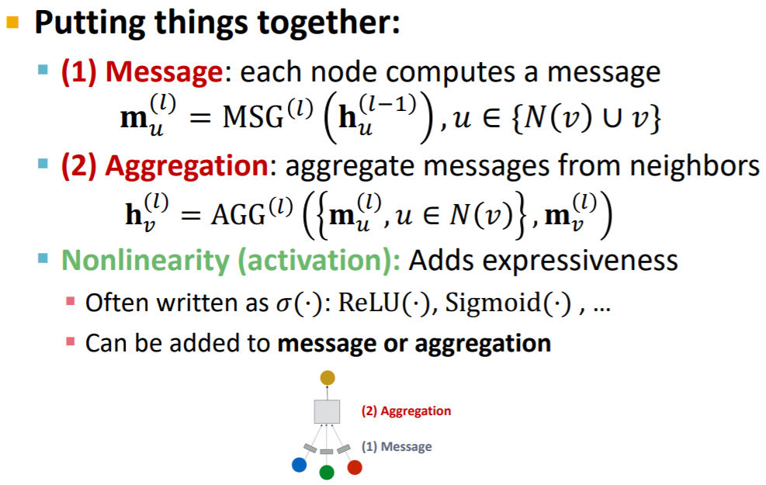
Graph Neural Network

Slide 39
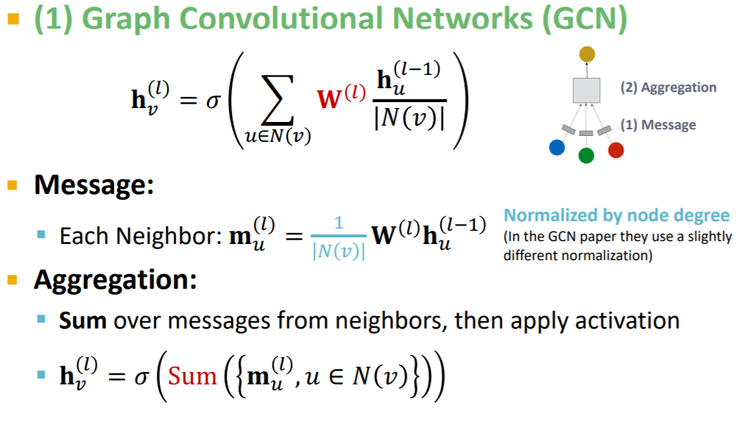
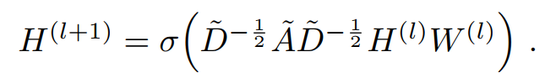
Graph Convolutional Network

Slide 40
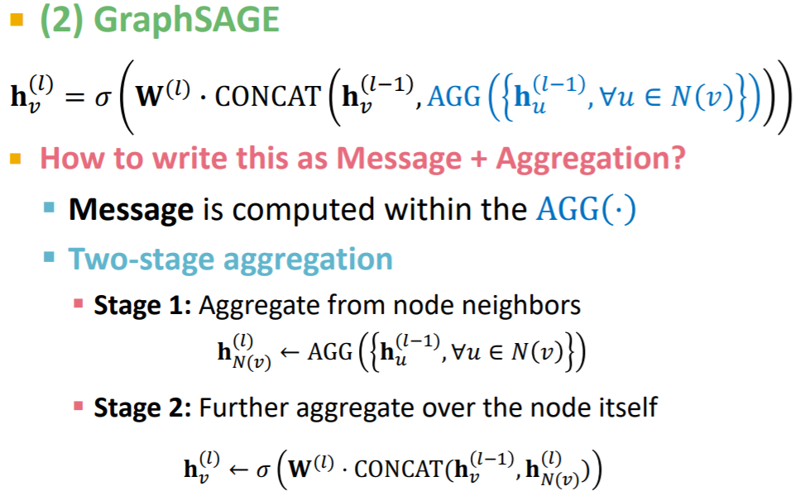
Graph SAGE

Slide 41
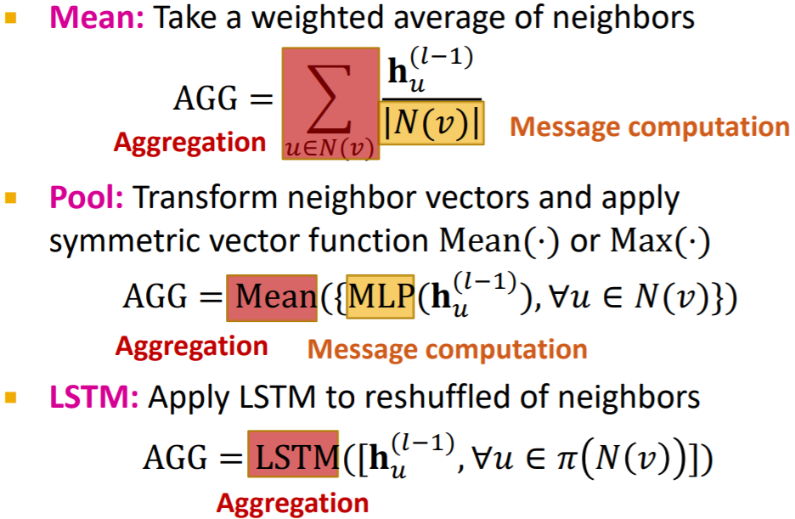
Graph SAGE

Slide 42
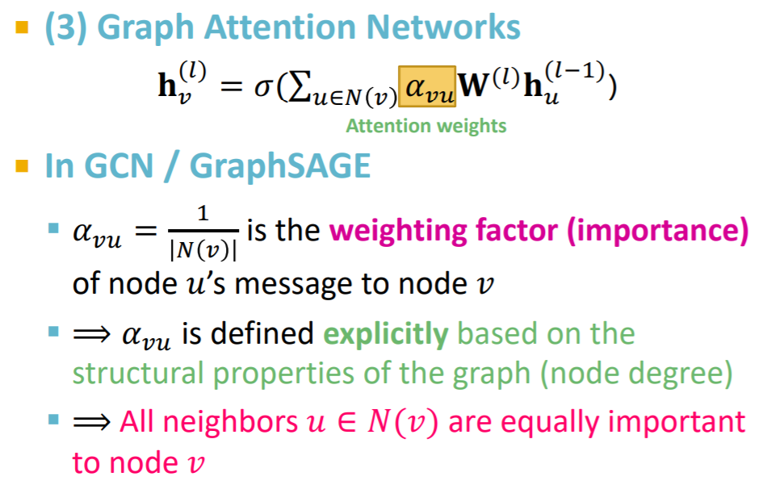
Graph Attention Graph (GAT)

Slide 43
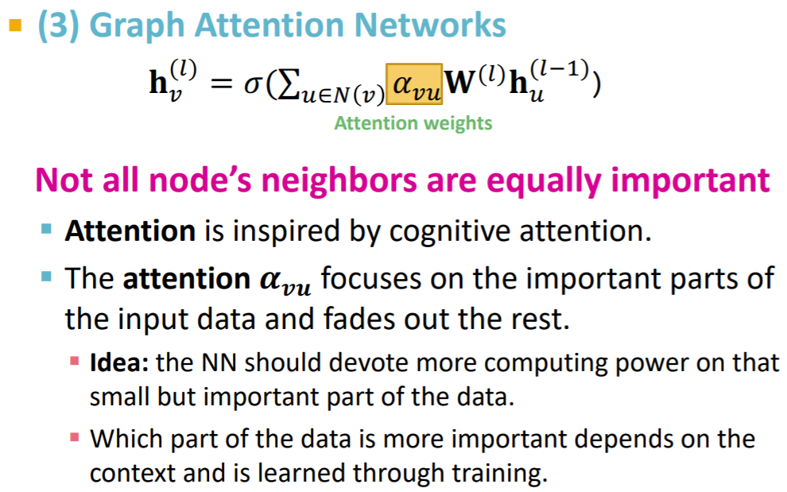
Graph Attention Graph (GAT)

Slide 44
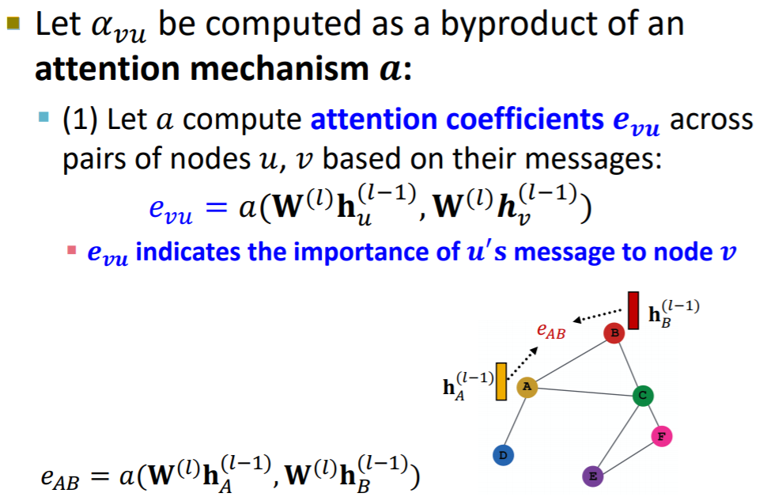
Graph Attention Graph (GAT)

Slide 45
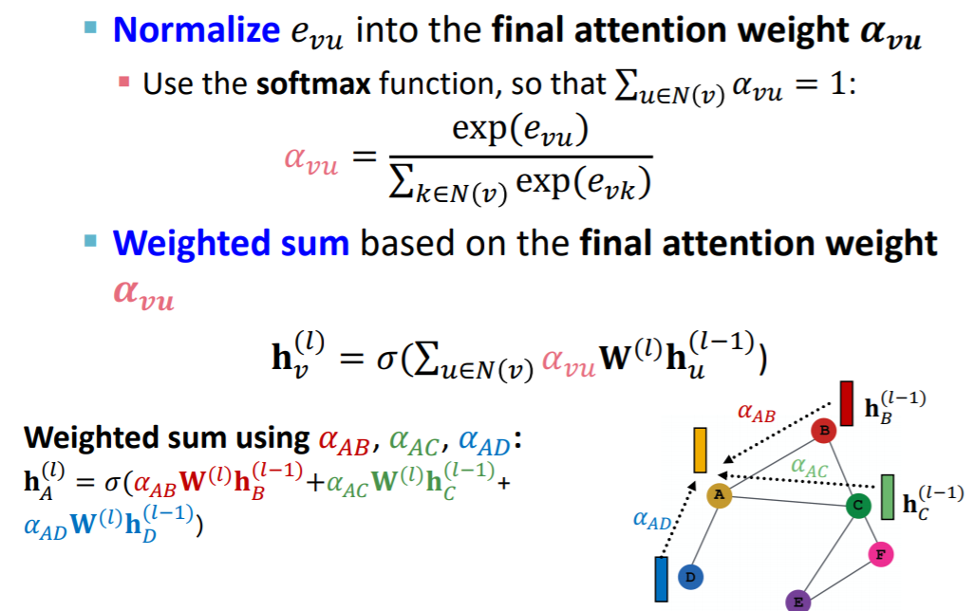
Graph Attention Graph (GAT)

Slide 46
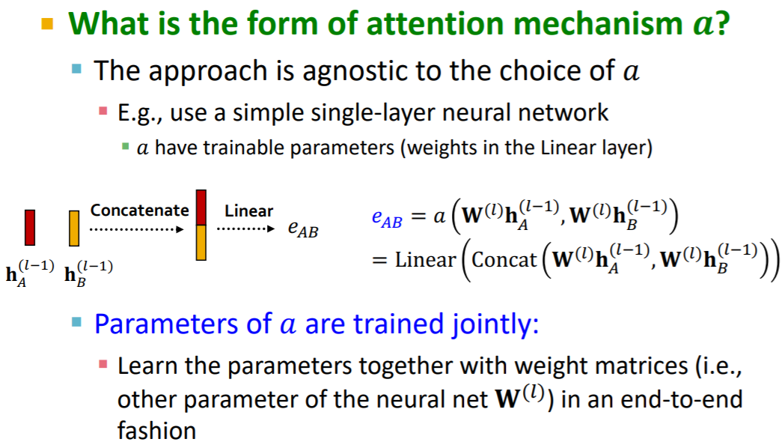
Graph Attention Graph (GAT)

Slide 47
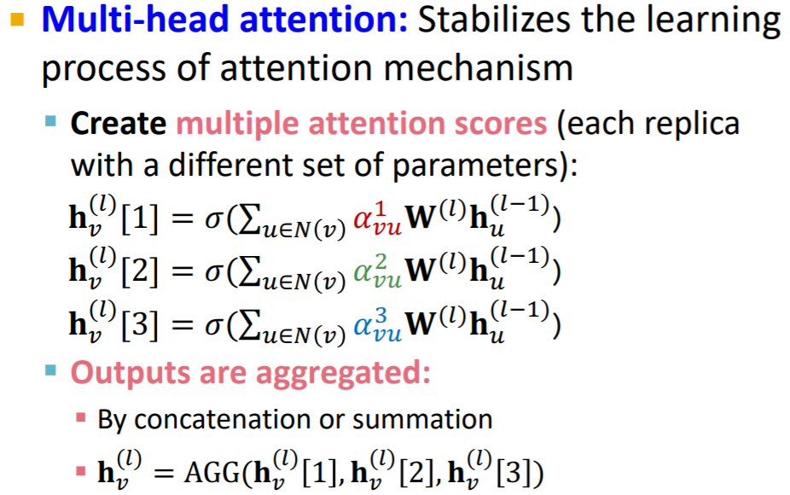
Graph Attention Graph (GAT)

Slide 48
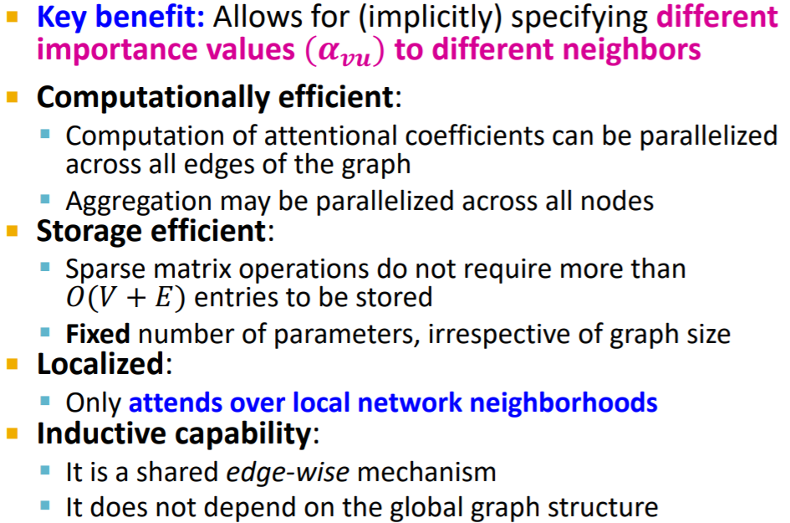
Graph Attention Graph (GAT)

Slide 49
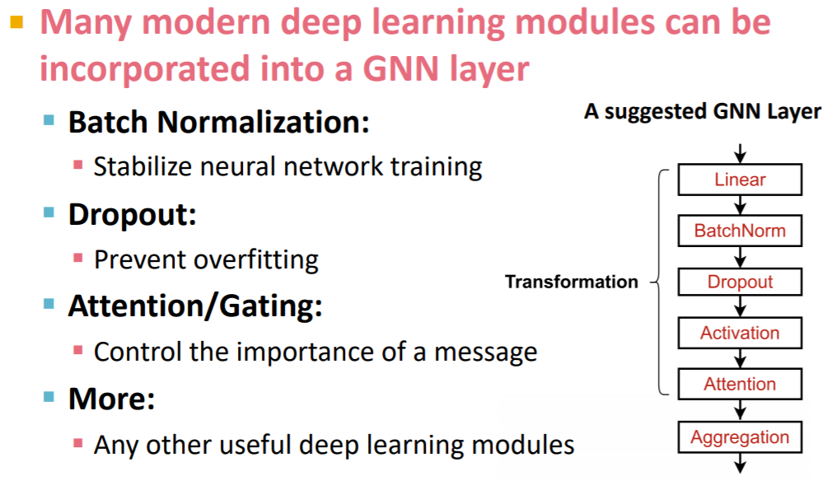
TIPS

Slide 50
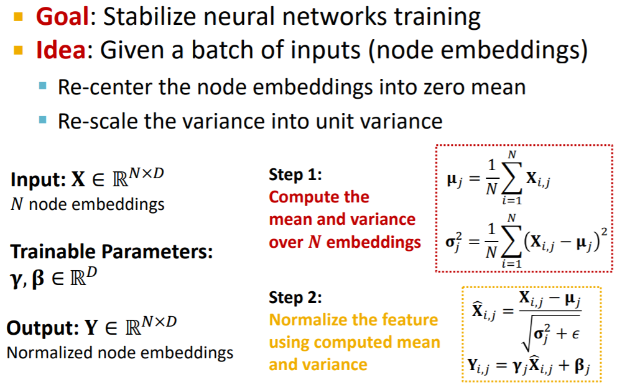
TIPS

Slide 51

TIPS

Slide 52
TIPS

Slide 53

TIPS

Slide 54

TIPS

Slide 55

Graph Isomorphism Network (GIN)

Slide 56

Graph Isomorphism Network (GIN)

Slide 57

Graph Isomorphism Network (GIN)

Slide 58

Graph Isomorphism Network (GIN)

Slide 59

Graph Isomorphism Network (GIN)

Slide 60

Graph Isomorphism Network (GIN)

Slide 61

Graph Isomorphism Network (GIN)

Slide 62

Graph Isomorphism Network (GIN)

Slide 63

Graph Isomorphism Network (GIN)

Slide 64

Graph Isomorphism Network (GIN)

Slide 65

Graph Isomorphism Network (GIN)

Slide 66

Biomedical Applications

Slide 67

Disease Pathway

Slide 68

Disease Pathway

Slide 69

Protein-Protein Interaction (PPI)

Slide 70

Protein Function Prediction

Slide 71

Protein Function Prediction

Slide 72

Protein Function Prediction

Slide 73

Multi-Layer Graph

Slide 74

Multi-Layer Graph

Slide 75

Multi-Layer Graph

Slide 76

Multi-Layer Graph

Slide 77

Multi-Layer Graph

Slide 78

Multi-Layer Graph

Slide 79

Multi-Layer Graph
Notes:
Metapath2vec

Slide 80

Side-effect prediction

Slide 81

Side-effect prediction

Slide 82

Side-effect prediction

Slide 83

Side-effect prediction

Slide 84

Side-effect prediction

Slide 85

Side-effect prediction

Slide 86

Side-effect prediction

Slide 87

Side-effect prediction

Slide 88

Side-effect prediction

Slide 89

New tricks for old graph

Slide 90

New tricks for old graph

Slide 91

New tricks for old graph

Slide 92

Technologies

Slide 93

Drugs Discovery - Goal-directed generation (GCPN)

Slide 94

New Directions

Slide 95

New Directions

Slide 96

New Directions

Slide 97

New Directions

Slide 98

New Directions

Slide 99

New Directions

Slide 100
References
Xiang Yue. et al. (2020) Graph embedding on biomedical networks: methods, applications and evaluations. Bioinformatics, 36, 1241-1251.
http://videolectures.net/icgeb_zitnik_network_embeddings/
http://videolectures.net/icgeb_zitnik_graph_neural_networks/
CS224W: Machine Learning with Graphs.
Inductive Representation Learning on Large Graphs.
Predicting multicellular function through multi-layer tissue networks
SEMI-SUPERVISED CLASSIFICATION WITH GRAPH CONVOLUTIONAL NETWORK
GRAPH ATTENTION NETWORKS.
How Powerful are Graph Neural Networks?
And so on …

